Slide 1

Entrepreneurship Development Programme

Slide 2
Modules & Topics
Modules | Topic | Sub Topics
1 | Soft Skills | Self-Awareness Grooming Body Language Developing Self- Confidence Communication Teamwork Active Listening & Probing Time Management
2 | Technical Skills and Managerial Skills | Goal setting and risk taking Entrepreneurial competencies and its internalization Negotiation skills / Convincing abilities and its steps Leadership Failures and how to overcome failures
3 | Personality Development | Interaction Rapport building (Relationship building) Connecting with customers
4 | Offline Product Scrutiny and Email Etiquette | Knowing the product Identifying the product Email writing

Slide 3
Modules & Topics
5 | Pricing | Manufacturing cost Material cost Making charges Profit and delivery Demand and Supply
6 | Production Management | Purchasing Techniques Quality Management Packaging Cost Control and Management Maintenance and Industrial Safety
7 | Market Survey | Market frame Price of the product Demand Source Connecting to the vendor Catalogue
8 | Marketing & Government Scheme and Policy | The 4 P's (Product, Price, Place, Promotion) Policies for MSME, Cultural Group, Micro Enterprises

Slide 4
Module 1: Soft Skills
Meaning: Soft Skills are personal qualities that allow us to relate with others. Soft skills covers both personality.
Self-Awareness
Grooming
Body Language
Confidence
Teamwork
Active Listening & Probing
Time Management

Slide 5
Self Awareness
Self-awareness skills, as the term indicates, refer to one's ability to be aware of or to recognize his emotions, behaviors, beliefs, motivations.
6 Ways to Improve Self Awareness
ASK FOR FEEDBACK
RECOGNISE STRENGTHS AND WEAKNESSES
BETTER SELF-REFLECTION
MONITOR SELF-TALK
QUESTION DECISIONS
FINAL THOUGHT
Notes:
Reference:
https://blog.innerdrive.co.uk/6-ways-to-improve-self-awareness

Slide 6
Grooming
Grooming your personality is just as important as grooming your outward appearance. When you regularly work on developing good personality traits and minimizing bad ones, you'll make more friends, do better at work, and feel happier overall.
6 Impacts of Self Grooming
Affects The Way You Think
Revitalizing Your Behaviour
Affects People’s Perception Of You
Keeps You Up-To-Date
Long Term Profession
Makes You Productive
Notes:
Video Link:
https://www.youtube.com/watch?v=lxeSuF-D1WQ
Reference Link:
https://management30.com/blog/the-top-6-ways-self-grooming-behavior-impacts-ones-professional-life/

Slide 7
Body Language
Before you’ve even said a word, the person across from you has noticed your body position, posture, facial expressions, and more. For this reason, your body language is important in making a first impression and being remembered. Building strong body language is going to make you seem more confident in any interaction.
Best Body Language Tips For Making A Great Impression:
Eye contact
Posture
Body movements and gestures
Facial expression
Attire
Notes:
Reference:
https://careersidekick.com/body-language-tips/

Slide 8
Confidence
Confidence is built on different things, but overall it is built on choices and accomplishments that feed your passion, and that make you feel happy and proud of who you are. Discovering these things is one of the most worthwhile pursuits of you life.
7 ways you can begin building your confidence:
Get Things Done
Monitor Your Progress
Be Fearless
Stand-up For Yourself
Think Long-term
Don't Care What Others Think
Do More Of What Makes You Happy
Notes:
Reference:
https://www.forbes.com/sites/francesbridges/2017/07/21/10-ways-to-build-confidence/?sh=17dce4af3c59

Slide 9
Teamwork
Successful teams tend to be successful because they're more than a bunch of individuals who happen to be working together; their relationships, their direction and their ways of working and collaborating together mean that the whole becomes greater than the sum of its parts.
6 Keys to Successful Teamwork
Clear common purpose, goals and identity
Respect and tolerance for the differences in every team member
Balanced communications among all team members
Build trust with everyone on the team
Don't let little things become big things
Live with imperfection and the unknown

Slide 10
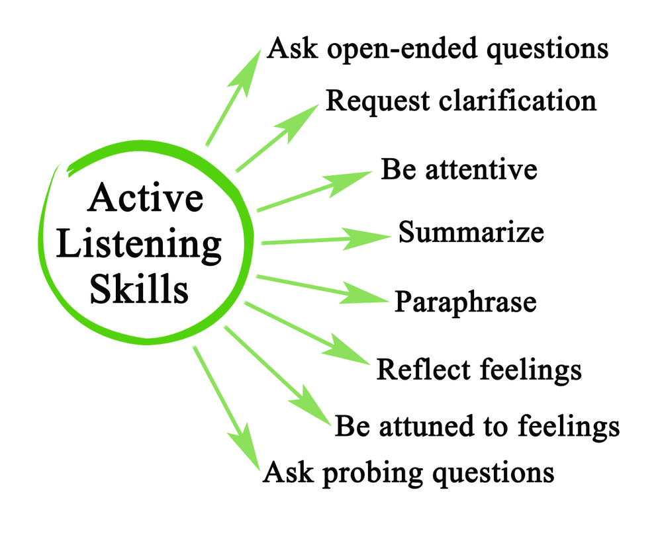
Activities

Slide 11
Module 2: Technical Skills and Managerial skills
Technical Skills - Technical skills are the specialized knowledge and expertise required to perform specific tasks and use specific tools.
Managerial Skills - are a collection of abilities that include things such as business planning, decision-making, problem-solving, communication.
Goal setting and risk taking
Entrepreneurial competencies and its internalization
Negotiation skills / Convincing abilities and its steps
Leadership
Failures and how to overcome failures

Slide 12
Goal setting and risk taking
How do companies use Business Risk as a goal setting tool?
1.First thing’s first, companies must determine where they are to establish where they want to go.
2 .Many businesses define a 3-5 year goal, with a stretch vision for 10 years in the future.
Let’s assume Company XYZ has clearly defined their target goal with detailed plans and actions for each department. But what they may have not considered are the possibilities of delays, traffic jams or wrong turns unmarked on their company’s road map. How can a company prepare for these unfavorable conditions if they don’t know what they are?

Slide 13
To plan for possible roadblocks, companies should consider the following questions
What are the company’s primary business goals?
What are the key business components that are necessary to achieve these goals?
What internal factors or events could derail these business components?
What external factors or events could derail these business components?
What are the 3 most significant risk events that impact the business’ ability to achieve our objectives?
What types of catastrophic risks does the organization face? How prepared is the organization to handle them if they occur?
What factors could impact third parties, such as vendors or service providers?
Should the organization be aware of any significant financial market risks?
What current or developing legal, regulatory, and governmental events or risks might be significant to the success of the business?

Slide 14
Managerial skills
A good manager has all the skills and can implement those skills for running the organization properly. 5 managerial skills are technical skills, conceptual skills,interpersonal and communication skills, decision-making skills.
Technical Skill.
Conceptual Skill.
Interpersonal and Communication Skills.
Decision-Making Skill.
Diagnostic and Analytical Skills.

Slide 15
2. Conceptual Skill - Conceptual skills are thinking skills which let you grasp complex ideas and come up with answers for difficult problems. These skills are valuable because they allow people to find many solutions for different challenges through deliberate thought and abstract reasoning.
3.Interpersonal and Communication Skills - Interpersonal communication involves the information, ideas, and feelings being exchanged verbally or nonverbally between two or more people.
Technical Skill -Technical skills are the specialized knowledge and expertise required to perform specific tasks and use specific tools and programs in real world situations.

Slide 16
4.Decision-Making Skill - Decision-making skills are all of the skills you need to make an informed, rational decision. Someone with good decision-making skills at work can assess all the facts, understand the company's current state and goal state, and choose the best course of action.
5.Diagnostic skill - refers to the ability to visualize the best response to a situation. Analytical skill means, the ability to identify the key variables in a situation. Manager diagnostic skill and Analytical skill helps him to identify possible approaches to a situation.

Slide 17
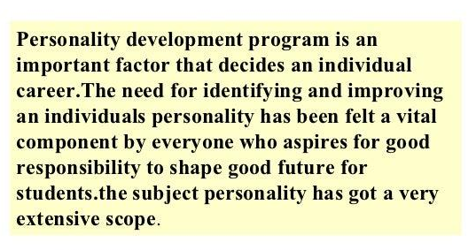
Module 3: Personality Development

Slide 18
Interaction and Communication
Communication in the workplace has dynamically progressed with recent changes in technology, leading to new standards of contacting those you work with. As a result, there are a handful of ways to improve your communication skills that pertain to your professional life.

Slide 19
Ways for Better Communication
Communicate face-to-face whenever possible
Provide clear information
Combine verbal and nonverbal communication
Don’t just hear – listen
Ask questions
Handle conflicts with diplomacy
Refrain from gossip
Avoid being personal with your co-workers
Avoid discussing controversial topics
Offer positive feedback
Notes:
Reference:
https://fremont.edu/top-10-tips-for-effective-workplace-communication/

Slide 20

Communicating with convincing messaging
1 on 1 and Group Discussions
Participate, Conduct
Body Language
Tone, gestures, eye contact, empathy
Convincing communication
Presenting an idea
Verbal, Written, templates and formats
Compelling idea Introduction and leading action Items
What is in it for them ?
Starting a conversation
Greet, Engage, Listen
Value proposition and negotiation

Slide 21

Rapport Building
Rapport is a harmonious relationship between people who have established mutual trust. Building rapport is how humans connect, identify shared feelings, and establish two-way communication.
Notes:
Ref:
https://www.masterclass.com/articles/how-to-build-rapport#why-is-rapport-important

Slide 22
6 Tips For Building Rapport
Remember people’s names.
Find common ground.
Actively listen
Ask questions.
Mind your body language
Reserve judgment
Notes:
Ref:
https://www.masterclass.com/articles/how-to-build-rapport#how-to-build-rapport-6-tips-for-connecting-with-others

Slide 23
Aligning the customer by understanding their needs
Identify | Potential customers, their needs, challenges, vision and goals
Approach | Reach, communicate frequently, build case step by step
Product Confidence | Features, functionalities, pricing, potential, future roadmap
Value Add | Potential sales, margin, growth
Customer Base | Target markets, growth plan, referrals, cross sell, up sell
Customer Engagement | Social media, emails, SMS and other channels, effective messaging formats and messaging
Understanding and orienting the customer

Slide 24
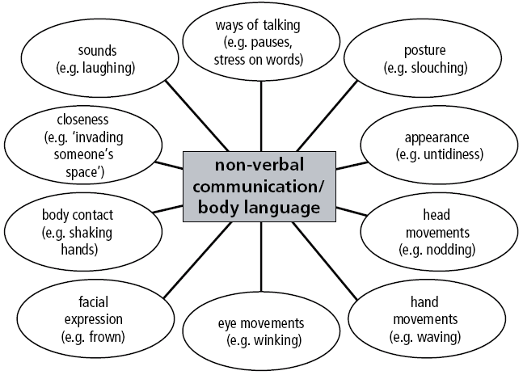
Activities

Slide 25
Module 4: Offline Product Scrutiny & Email Etiquette

Slide 26
Using digital channel to drive business
Importance and advantage | High reach, minimal expenditure, fast spread / virality
Accessibility | Easily accessible, varied audiences, various customizable channels and media
Mass Appeal | High coverage and frequent usage, easily reachable to remote audiences
Management | Easy to use, easy to manage, readily usable platforms and tools
Cell Phone | Mobile usability, update on the go, near real time improvement
Digital Marketing | Most used and impactful media now, low cost high returns, new ways of marketing
Create and Design | Customize for your product, brand and target audience
Applications | Multiple apps for various purposed from design, customization, delivery of pamphlets, brochures, posters

Slide 27
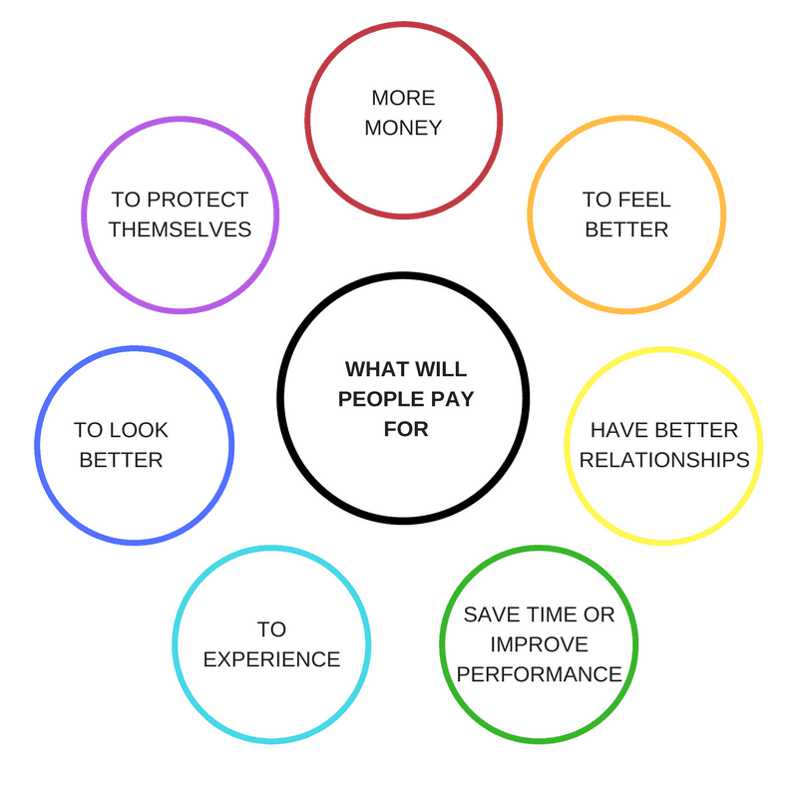
Identification of Products

Slide 28
Product Scrutiny
Your own experiences using the products
Product literature such as brochures and catalogues
Online forums
Internal sales records
Feedbacks from customers
Your team members
Visits to manufacturers
Sales training programs
Competitor information.
Notes:
Reference:
https://www.business.qld.gov.au/running-business/marketing-sales/sales/skills/know-product

Slide 29
Email Writing
How To Write An Effective Email
Have a compelling subject line.
Start with an appropriate greeting.
Have a strong attention grabber.
Keep your message short and concise.
Be consistent with your font.
Write a simple closing.
Schedule your emails.
Do a final spelling and grammar check
Notes:
Video Link:
https://www.youtube.com/watch?v=vOvNUjwXlOQ

Slide 30
Module 5: Pricing
Meaning of Pricing:
Pricing is a process of fixing the value that a manufacturer will receive in the exchange of services and goods. Pricing method is exercised to adjust the cost of the producer’s offerings suitable to both the manufacturer and the customer.

Slide 31
Every businessperson starts a business with a motive and intention of earning profits. This ambition can be acquired by the pricing method of a firm. While fixing the cost of a product and services the following point should be considered:
The identity of the goods and services
The cost of similar goods and services in the market
The target audience for whom the goods and services are produces
The total cost of production (raw material, labour cost, machinery cost, transit, inventory cost etc).
External elements like government rules and regulations, policies, economy, etc.

Slide 32

Objectives of Pricing:
Survival
Expansion of current profits
Ruling the market
A market for an innovative idea
Notes:
Ref:
https://byjus.com/commerce/what-is-pricing/

Slide 33
Survival-
The objective of pricing for any company is to fix a price that is reasonable for the consumers and also for the producer to survive in the market. Every company is in danger of getting ruled out from the market because of rigorous competition, change in customer’s preferences and taste. Therefore, while determining the cost of a product all the variables and fixed cost should be taken into consideration. Once the survival phase is over the company can strive for extra profits.
Expansion of current profits-
Most of the company tries to enlarge their profit margin by evaluating the demand and supply of services and goods in the market. So the pricing is fixed according to the product’s demand and the substitute for that product. If the demand is high, the price will also be high.

Slide 34
Ruling the market-
Firm’s impose low figure for the goods and services to get hold of large market size. The technique helps to increase the sale by increasing the demand and leading to low production cost.
A market for an innovative idea-
Here, the company charge a high price for their product and services that are highly innovative and use cutting-edge technology. The price is high because of high production cost. Mobile phone, electronic gadgets are a few examples.

Slide 35
Determining Manufacturing Costs
What are the manufacturing costs?
Manufacturing costs are the funds and costs associated in the business for one time
Why do you need to determine the manufacturing costs?
To know the costs required for the business, in production
Do be used in determining the cost of selling the product or to determine the price
To determine that when the product is sold, you get a profit or loss

Slide 36
Determining Manufacturing Costs
What do the manufacturing costs include?
The cost of materials
The cost of equipment
The cost of labour
The cost of materials for packaging
The cost of electricity and water
The cost of transportation
The cost of promotion and advertising
The cost of management and co-ordination

Slide 37
Determining Manufacturing Costs
Profit and loss
This is determined by comparing the income with manufacturing costs.
Profit means the money made from the income which is more than the manufacturing costs or selling the product at a cost higher than the capital investment.
Loss means the amount when the income is less than the manufacturing costs

Slide 38
Module 6. Production Management
Production management - Aims to monitor and improve the efficiency of activities, materials, staff resources, and budgets to produce goods. Production outcomes vary according to the industry. A production manager ensures that manufacturing stays on schedule, within budget, and achieves the desired output goals.
Production management has three main functions:
1.Planning
2.control
3.coordination.
.

Slide 39

Planning is setting objectives and determining the course of action to achieve those objectives. Coordination is the process of aligning all resources and activities to achieve objectives.
4 M’s of Production Management - Machines, Manpower, Methods, and Material.

Slide 40
Module 5: Market Survey

Slide 41
Business Management | Problem solving, logical thinking, practical approach
Running a business | Organizational skills, business and operations planning, risk planning
Vision | Short term and long term goal, step by step execution plan for the goal, sustenance and growth plans
Decision Making | Confidence in facts, insights and data, logical interpretations, confident decision and judgement abilities
Risk vs Returns | Risk appetite, profit expectations

Slide 42
Market Survey - Meaning
Market survey is the survey research and analysis of the market for a particular product/service which includes the investigation into customer inclinations. A study of various customer capabilities such as investment attributes and buying potential. Market surveys are tools to directly collect feedback from the target audience to understand their characteristics, expectations, and requirements.

Slide 43
Purpose of Market Survey
Gain critical customer feedback: The main purpose of the market survey is to offer marketing and business managers a platform to obtain critical information about their consumers so that existing customers can be retained and new ones can be got onboard.
Understand customer inclination towards purchasing products: Details such as whether the customers will spend a certain amount of money for their products/services, inclination levels among customers about upcoming features or products, what are their thoughts about the competitor products etc.
Notes:
Ref:
https://www.questionpro.com/blog/market-survey/

Slide 44
Purpose of Market Survey
3. Enhance existing products and services: A market survey can also be implemented with the purpose of improving existing products, analyze customer satisfaction levels along with getting data about their perception of the market and build a buyer persona using information from existing clientele database.
4. Make well-informed business decisions: Data gathered using market surveys is instrumental in making major changes in the business which reduces the degree of risks involved in taking important business decisions
Notes:
Ref:
https://www.questionpro.com/blog/market-survey/

Slide 45
Building Proposals
How to build proposal | Value proposition, plan, cost, benefits
Business Identity | Unique identifier, detailed information, reachability and accessibility of business
Pricing and Methodology | Per unit, bulk, Bundles, Discounts, Offers,
Outline | End to end proposal overview, outlines, details, basis of information, commitment

Slide 46
Setting up a Business
Business Reports | - Survey Questionnaire, Survey Findings - Outcomes, Product Finalization, Methods of Manufacturing - Transportation Issues, Competition for the product, repeated mass appeal
Use of SWOT Analysis | STRENGTH:- What do you do well, What Unique resources can you draw on, what do others see as your strengths. WEAKNESS:- What could you improve?, Where do you have fewer resources than others, What are others likely to see as weakness. OPPORTUNITY :-What opportunity are open to you, What trends could you take advantage of, How can you turn your strength into opportunity. THREATS:- What threats can harm you, What is your competitor doing, What threats do your weakness expose to you.
Capital requirement and other financial indicators. | Budget require for your business plan, Setup cost, inventory cost, Tools Cost, Labor Wages
Developing a strong business profile | Put Basic information about your company/ Business Put your company idea Outline mission statement
Psychological aspects | Mental, Physical, Emotional, Social and Financial
Material selection | Quantity, quality, price, availability, sourcing
Goal Setting | Targets, attainment, gaps

Slide 47
Catalogue Making
How to Make a Product Catalog
Gather your content.
Produce visually appealing product images
Know your product features
Choose an appropriate size for your catalog
Choose the right amount of pages
Write product descriptions
Notes:
https://www.wikihow.com/Make-a-Product-Catalog

Slide 48
Module 6: Government Schemes & Policies
(Maharashtra)

Slide 49
Udyog Aadhaar Memorandum.
Quality Management Standards & Quality Technology Tools
Grievance Monitoring System
Incubation
Credit Linked Capital Subsidy Scheme.
Women Entrepreneurship.
Notes:
Ref:
https://cleartax.in/s/msme-schemes-india
http://di.maharashtra.gov.in/_layouts/15/doistaticsite/English/investors_guide_msme.html

Slide 50
Maharashtra Govt Special Policy for Women Entrepreneurs
The policy stated that a woman entrepreneur would get from Rs 15 lakh up to Rs 1 crore financial assistance in a proportion of 15%-35% of the capital investment of project at the subsidized rate of interest up to 5%
In order to benefit the women, the policy has defined the woman entrepreneur as ‘a group of women entrepreneurs who have financed 100% for the project and hired minimum 50% women employees’ would be treated as the women entrepreneur.
Notes:
https://www.newindianexpress.com/nation/2017/dec/05/maharashtra-government-announces-special-policy-for-women-entrepreneurs-1719292.html

Slide 51
Top 6 Government Loan Schemes for Startups & New MSMEs
MUDRA Loan under PMMY
Stand-Up India
PSB/MSME Loans in 59 Minutes
National Small Industries Corporation (NSIC) Subsidy
SIDBI Make in India Soft Loan Fund for MSMEs (SMILE)
Credit Guarantee Scheme (CGS)
Notes:
https://www.paisabazaar.com/business-loan/government-business-loans/

Slide 52
5 Steps to Register
Step 1: Go to the nearest bank’s official website eligible to offer loans under Govt. schemes
Step 2: Register on the portal and login through the One-Time Password (OTP) authentication
Step 3: Agree to the terms and conditions of the Government loan scheme
Step 4: Enter your financial credentials and other information required
Step 5: Proceed further and continue with filling the forms and uploading the required documents
Notes:
https://www.paisabazaar.com/business-loan/government-business-loans/

Slide 53
Managing Finances
Funds | Availability, quantity, quality, trust
Sources
Budget | Estimation, planning, actuals vs planned risks and overheads
Forward Planning | Uncertain situations, risk identification, leading indicators
Knowledge of available resources | Subsidy, loans, public funds, schemes
Taxes | Awareness, calculations, reserving funds, implications and penalties
Income | Generation sources, tracking, record maintenance, estimate expected incomes
Schemes and Loans | Availability, repayment, calculations of interest vs returns vs cost
Loan Criteria | Individual vs groups , SHGs, MSME

Slide 54
Managing Finances
Cost | Cost drivers, cost influencers,
Business Impact | Impact of cost on business – operations, cost, profit
Minimizing Cost | Overhead costs, delay-able cost, minimizable cost
Types of Cost | Fixed, variable, avoidable vs unavoidable
Breakeven Concept | Investment (self vs sourced), stage wise returns, recovery and breakeven
Cost Elements | Manufacturing cost, Selling Costing and Profit calculations
Records and Documentation | Records maintenance, invoices documentation and maintenance, Calculations

